Slide 1
BCA Fifth Semester CACS301: MIS and E-Business

Slide 2
Security
Information security, or information systems security, refers to a variety of activities and methods that protect information systems, data, and procedures from any action designed to destroy, modify, or degrade the systems and their operations.
Computer security in general refers to the risks and protection of data, networks, computer programs, computer power, and other elements of computerized information systems.
It is a very broad field due to the many methods of attack as well as the many modes of defense.
The attacks on and defenses for computers can affect individuals, organizations, countries, or the entire Web.
Computer security aims to prevent, repair, or at least minimize the attacks.
E-commerce security is the protection of e-commerce assets from unauthorized access, use, alteration, or destruction.

Slide 3
Threat, attack and attacker
Anything potential to cause harm to the computer system system or organization.
A threat is a possible danger that might exploit a vulnerability to breach security and therefore cause possible harm.
A threat can be either "intentional" or "accidental" or otherwise a circumstance, capability, action, or event.
Unintentional threats fall into three major categories: human error, environmental hazards, and malfunctions in the computer system.
In computers and computer networks an attack is any attempt to expose, alter, disable, destroy, steal or gain unauthorized access to or make unauthorized use of an asset.
an attacker is the individual or organization performing these malicious activities
Intentional Attacks and Crimes
Intentional attacks are committed by cybercriminals.
Types of intentional attacks include theft of data, inappropriate use of data (e.g., changing it or presenting it for wrong purposes), theft of laptops and other devices and equipment, and/or inserting computer programs to steal data, damage directed toward the computer or its information system, damaging computer resources, losses from malware attacks, creating and distributing viruses, and causing monetary losses due to Internet fraud.

Slide 4
Threat, attack and attacker
Intentional crimes carried out using computers and the Internet are called cybercrimes, which are done by cybercriminals (criminals for short) that include hackers and crackers. A hacker describes someone who gains unauthorized access to a computer system. A cracker (also known as a black hat hacker) is a malicious hacker with extensive computer experience who may be more damaging.

Slide 5
Parameters | Hackers | Crackers
Definition | Hackers are good people who hack devices and systems with good intentions. They might hack a system for a specified purpose or for obtaining more knowledge out of it. | Crackers are people who hack a system by breaking into it and violating it with some bad intentions. They may hack a system remotely for stealing the contained data or for harming it permanently.
Skills and Knowledge | They have advanced knowledge of programming languages and computer OS. Hackers are very skilled and intelligent people. | These people may be skilled. But most of the time, they don’t even need extensive skills. Some crackers only have a knowledge of a few illegal tricks that help them in stealing data.
Role in an Organization | Hackers work with specific organizations to help them in protecting their information and important data. They mainly provide organizations with expertise in security and internet safety. | Crackers harm an organization. These are the people from whom hackers defend sensitive data and protect the organizations as a whole.
Ethics | These are ethical types of professionals. | These are illegal and unethical types of people who only focus on benefiting themselves with their hacking.

Slide 6
Basic EC Security Terminology
Business continuity plan: A plan that keeps the business running after a disaster occurs. Each function in the business should have a valid recovery capability plan.
Cybercrime: Intentional crimes carried out on by using the Internet.
Cybercriminal: A person who intentionally carries out crimes over the Internet.
Exposure: An instance of being exposed to losses from an attack that exploits vulnerability (including estimate of damages).
Fraud: Any business activity that uses deceitful practices or devices to deprive another of property or other rights.
Vulnerability: Weakness or fault that can lead to an exposure.
Malware: malicious code such as viruses, worms, Trojan horses, bots, backdoors, spyware, adware, etc.
Cyber vandalism: Intentionally disrupting, defacing or destroying a Web site.
Notes:
deceitful = guilty of or involving
Cyber vandalism = A cyber attack without any obvious rational criminal, political, or ideological motive, usually defacement of a vulnerable website to display the hacker's prowess

Slide 7
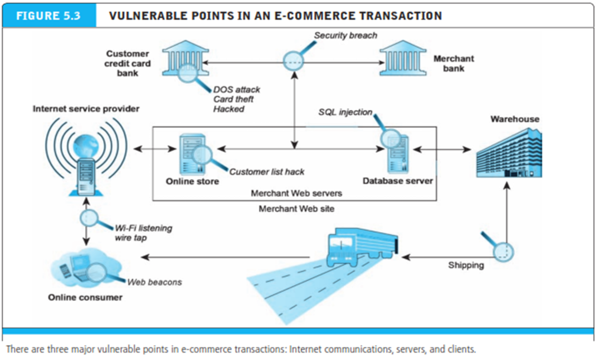
E-commerce Security Concern

Slide 8
EC Security Requirements
Authentication is a process used to verify (assure) the real identity of an EC entity, which could be an individual, software agent, computer program, or EC website. For electronic messages, authentication verifies that the sender/receiver of the message is who the person or organization claims to be (the ability to detect the identity of a person/entity with whom you are doing business).
Authorization is the provision of permission to an authenticated person to access systems and perform certain operations in those specific systems.
Auditing. When a person or program accesses a website or queries a database, various pieces of information are recorded or logged into a file. The process of maintaining or revisiting the sequence of events during the transaction, when and by whom, is known as auditing.
Availability Assuring that systems and information are available to the user when needed and that the site continues to function. Appropriate hardware, software, and procedures ensure availability.
Nonrepudiation. Closely associated with authentication is nonrepudiation, which is the assurance that online customers or trading partners will not be able to falsely deny their purchase, transaction, sale, or other obligation. Nonrepudiation involves several assurances, including providing proof of delivery from the sender and proof of sender and recipient identities and the identity of the delivery company.

Slide 9
EC Security Requirements
Confidentiality : For sender, intended receiver should understand message contents using encryption and decryption. For sender, intended receiver should understand message contents.
Integrity: sender and receiver want to make sure that the message are not altered without detection.

Slide 10
Technical Malware attack
Hackers often use several software tools (which unfortunately are readily and freely available over the Internet together with tutorials on how to use them) in order to learn about vulnerabilities as well as attack procedures.
Malware (Malicious Software): Viruses, Worms, and Trojan Horses:
Malware is a software program that, when spread, is designed to infect, alter, damage, delete, or replace data or an information system without the owner’s knowledge or consent.
Malware is a comprehensive term that describes any malicious program or software
Malware attacks are the most frequent security breaches.
Computer systems infected by malware take orders from the criminals and do things such as send spam or steal the user’s stored passwords. (keylogger)

Slide 11
Technical Malware attack
Viruses
A virus is programmed software inserted by criminals into a computer to damage the system; running the infected host program activates the virus. A virus has two basic capabilities.
First, it has a mechanism by which it spreads.
Second, it can carryout damaging activities once it is activated.
Sometimes a particular event triggers the virus’s execution.
The problem is that existing virus protection systems may not work against new viruses, and unfortunately, new viruses are created all the time.

Slide 12
Technical Malware attack
Worms
Unlike a virus, a worm can replicate itself automatically (as a “stand-alone” without any host or human activation). Worms use networks to propagate and infect a computer or handheld device and can even spread via instant messages or e-mail. In addition, unlike viruses that generally are confined within a target computer, a worm can infect many devices in a network as well as degrade the network’s performance.
Trojan Horse
A Trojan horse is a program that seems to be harmless or even looks useful but actually contains a hidden malicious code. Users are tricked into executing an infected file, where it attacks the host, anywhere from inserting pop-up windows to damaging the host by deleting files, spreading malware, and so forth. e.g., Zeus, W32

Slide 13
Technical Malware attack
Heartbleed
Heartbleed is a flaw in OpenSSL, the open-source encryption standard used by the majority of websites that need to transmit the data that users want to keep secure. It basically gives you a secure line when you’re sending an e-mail or chatting on IM.”
The potential damage may be large. In theory, any data kept in the active memory can be pulled out by the bug. Hackers can even steal encryption keys that enable them to read encrypted messages. About 650 million websites may be affected. The only advice provided by experts is to change the online passwords.

Slide 14
Technical Malware attack
Crypto Locker:
Discovered in September 2013, CryptoLocker is a ransomware Trojan bug. This malware can come from many sources including e-mail attachments and can encrypt files on your computer, so that you cannot read these files. The malware owner then offers to decrypt the data in exchange for a Bitcoin or similar untraceable payment system.

Slide 15
Technical Malware attack
A denial-of-service (DoS) attack is “a malicious attempt to make a server or network resource unavailable to users, usually by temporarily interrupting or suspending the services of a host connected to the Internet.”
This causes the system to crash or become unable to respond in time, so the site becomes unavailable. One of the most popular types of DoS attacks occurs when a hacker “floods” the system by overloading the system with “useless traffic” so a user is prevented from accessing their e-mail, websites, etc.
A DoS attack is a malicious attack caused by one computer and one Internet connection as opposed to a distributed denial-of-service (DDoS) attack, which involves many devices and multiple Internet connections. For example, the attack on the Dyn(closing case) was done by thousands of computers taken hostage by the hackers.

Slide 16
Technical Malware attack
Page hijacking or pagejacking is illegally copying website content so that a user can be misdirected to a different website. Social media accounts are sometimes hijacked for the purpose of stealing the accountholder’s personal information.
Botnets
A botnet (also known as “zombie army”) is a malicious software that criminals distribute to infect a large number of hijacked Internet-connected computers controlled by hackers. These infected computers then form a “botnet,” causing the personal computer to “perform unauthorized attacks over the Internet” without the user’s knowledge. Unauthorized tasks include sending spam and e-mail messages, attacking computers and servers, and committing other kinds of fraud, causing the user’s computer to slow down. Each attacking computer is considered computer robot. A botnet made up of 75,000 systems infected, in 2010, with Zeus Trojan contaminated computers.

Slide 17
Technical Malware attack
Malvertising
Malvertising is a malicious form of Internet advertising used to spread malware. Malvertising is accomplished by hiding malicious code within relatively safe online advertisements .
Note that hackers are targeting ads to hide malware at accelerating rates. For example, in 2013, Google disabled ads from over 400,000 sites that were hiding malware. A final word: If you get an e-mail that congratulates you on winning a large amount of money and asks you to “Please view the attachment,” don’t!

Slide 18
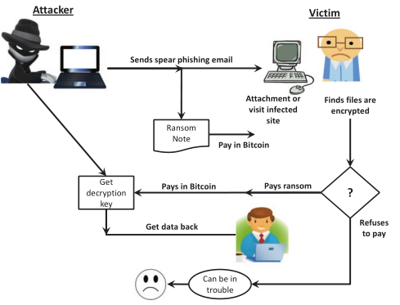
Technical Malware attack
Ransomware
Attacker encrypt and lock digital files by using malware and demand a ransom before the system is unlocked it.
A method of attack where the attacker encrypts files so the victim cannot open them unless they pay a ransom.

Slide 19
Technical Malware attack
Sniffing is the process of monitoring and capturing all the packets passing through a given network using sniffing tools. It is a form of “tapping phone wires” and get to know about the conversation. It is also called wiretapping applied to the computer networks.
A packet analyzer is a computer program or piece of computer hardware that can intercept and log traffic that passes over a digital network or part of a network. Packet capture is the process of intercepting and logging traffic.

Slide 20
Non-Technical malware attack
Software and systems knowledge are used to perpetrate technical attacks. Insufficient use of antivirus and personal firewalls and unencrypted communication are the major reasons for technical vulnerabilities.
Nontechnical organizational attacks are those where the security of a network or the computer is compromised (e.g., lack of proper security awareness training). We consider financial fraud, spam, social engineering, that includes phishing, and other fraud methods, as nontechnical.
Many nontechnical methods also use some malware in their attacks. The goals of social engineering are to gain unauthorized access to systems or information by persuading unsuspected people to disclose personal information that is used by criminals to commit fraud and other crimes.

Slide 21
Non-Technical malware attack
Social Engineering and Fraud
Social engineering refers to a collection of methods where criminals use human psychology to persuade or manipulate people into revealing their confidential information, or their employment information, so they can collect information for illegal activities.
The hacker may also attempt to get access to the user’s computer in order to install malicious software that will give hackers control over the person’s computer.
Social phishing is a fraudulent process of acquiring confidential information, such as credit card or banking details, from unsuspecting computer users.
A phisher sends an e-mail, IM, comment, or text message that appears to come from a legitimate, well-known, popular company, bank, school, or public institution.
The user is instructed to enter a corrupted website, where he or she may be tricked into submitting confidential information (e.g., being asked to “update” information). Sometimes phishers install malware to facilitate the extraction of information.

Slide 22
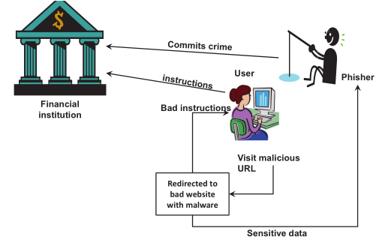
Non-Technical malware attack

Slide 23
Non-Technical malware attack
Pharming
Similar to phishing, pharming is a scam where malicious code installed on a computer is used to redirect victims to bogus(fake) websites without the victims’ knowledge or consent.
Pharming can be more dangerous than phishing since users have no idea that they have been redirected to a fake website.
Identity theft is a crime. It refers to wrongfully obtaining and using the identity of another person in some way to commit crimes that involve fraud or deception (e.g., for economic gain). Victims can suffer serious damages.

Slide 24
Non-Technical malware attack
Identity Fraud
Identity fraud refers to assuming the identity of another person or creating a fictitious person and then unlawfully using that identity to commit a crime. Typical activities include:
Opening a credit card account in the victim’s name
Making a purchase using a false identity (e.g., using another’s identity to buy goods)
Business identity theft is using another’s business name to obtain credit or to get into a partnership
Posing as another to commit a crime
Conducting money laundering (e.g., organized crime) using a fake identity
Notes:
Money laundering involves disguising financial assets so they can be used without detection of the illegal activity that produced them. Through money laundering, the criminal transforms the monetary proceeds derived from criminal activity into funds with an apparently legal source.

Slide 25
Non-Technical malware attack
Spam Attacks:
E-mail spam, also known as junk e-mail or just spam, occurs when almost identical messages are e-mailed to many recipients in bulk (sometimes millions of unsolicited e-mails).
Spammers can purchase millions of e-mail addresses and then format the addresses, cut and paste the messages, and press “send.” Mass e-mail software that generates, sends, and automates spam e-mail sending is called Ratware.
The situation is better today (2017) due to improved filtering of junk mail.
According to Symantec, most of messages on corporate networks are e-mail spam. Nearly 58% of spam came from botnets; the worst botnet was called Dotnet.

Slide 26
Non-Technical malware attack
Spyware is a tracking software that is installed by criminals, without the user’s consent, in order to gather information about the user and direct it to advertisers or other third parties.
Once installed the spyware program tracks and records the user’s movements on the Internet. Spyware may contain malicious code redirecting Web browser activity.
Spyware can also slow surfing speeds and damage a program’s functionality. Spyware usually is installed when you download freeware or shareware.

Slide 27
EC defense Strategy
EC security needs to address by the organization. An EC security framework that defines the high level categories of assurance and their controls is presented. The major categories are regulatory, financial, and marketing operations. Only the key areas are listed in bellow:
Defending access to computing systems, data flow, and EC transactions.
This includes three topics: Access control (including biometrics), encryption of contents, and public key infrastructure (PKI). This line of defense provides comprehensive protection when applied together. Intruders that circumvent the access control will face encrypted material even if they pass a firewall.
2. Defending EC networks.
This includes mainly protection by firewalls. The firewall isolates the corporate network and computing devices from the Internet that are poorly secured. To make the Internet more secure, we can use virtual private networks. In addition to these measures, it is wise to use intrusion detection systems. A protected network means securing the incoming e-mail, which is usually unencrypted. It is also necessary to protect against viruses and other malware that are transmitted via the networks.

Slide 28
EC defense Strategy
3. General, administrative, and application controls. These are a variety of safeguards that are intended to protect computing assets by establishing guidelines, checking procedures, and so forth.
4. Protection against social engineering and fraud. Several defense methods are used against spam, phishing, and spyware.
5. Disaster preparation, business continuity, and risk management. These topics are managerial issues that are supported by software.
6. Implementing enterprise-wide security programs. To deploy the abovementioned defense methods, one needs to use appropriate implementation strategy.
7. Conduct a vulnerability assessment and a penetration test.
8. Back up the data.

Slide 29
EC defense Strategy
Access Control
Access control determines who (person, program, or machine) can legitimately use the organization’s computing resources (which resources, when, and how).
Authorization and Authentication
Access control involves authorization (having the right to access) and authentication, which is also called user identification (user ID), i.e., proving that the user is who he or she claims to be. Each user has a distinctive identification that differentiates it from other users. Typically, user identification is used together with a password.
Authentication
After a user has been identified, the user must be authenticated. Authentication is the process of verifying the user’s identity and access rights. Verification of the user’s identity usually is based on one or more characteristics that distinguish one individual from another.

Slide 30
EC defense Strategy
Biometrics System
A biometric authentication is a technology that measures and analyzes the identity of people based on measurable biological or behavioral characteristics or physiological signals. Biometric systems can identify a previously registered person by searching through a database for a possible match based on the person’s observed physical, biological, or behavioral traits, or the system can verify a person’s identity by matching an individual’s measured biometric traits against a previously stored version. Examples of biometric features include fingerprints, facial recognition, DNA, palm print, hand geometry, iris recognition, and even odor/scent. Behavioral traits include voice ID, typing rhythm (keystroke dynamics), and signature verification.
A brief description of some of these follows:
Thumbprint or fingerprint. A thumb- or fingerprint (finger scan) of users requesting access is matched against a template containing the fingerprints of authorized .
Retinal scan. A match is sought between the patterns of the blood vessels in the retina of the access seekers against the retinal images of authorized people stored in a source database.
Voice ID (voice authentication). A match is sought between the voice pattern of the access seekers and the stored voice patterns of the authorized people.
Facial recognition. Computer software that views an image or video of a person and compares it to an image stored in a database (used by Amazon.com and Alibaba).
Signature recognition. Signatures of access seekers are matched against stored authentic signatures.

Slide 31
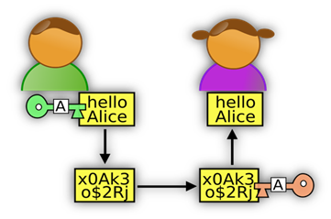
Encryption and PKI
The word “cryptography” derives from the Greek word for “secrete writing”.
Cryptography is a process associated with changing plaintext (ordinary text, or cleartext) into ciphertext (a process called encryption), and then backs again (known as decryption).
It is the conversion of data into a secret code for protection of privacy using a specific algorithm and a secret key.
It is used to protect e-mail messages, credit card information, and corporate data.
The primary goal of cryptography is to conceal (hide) data to protect it against unauthorized third-party access by applying encryption.
The more theoretical or mathematical effort is required for an unauthorized third party to recover data, the stronger is the encryption.

Slide 32
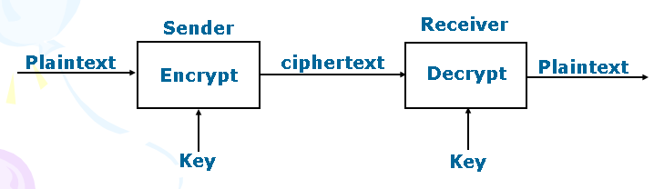

Encryption and decryption in cryptography
Encryption is the process of transforming plain text or data into cipher text that cannot be read by anyone outside of the sender and the receiver.
Decryption is the process of taking encrypted text or other data and converting it back into original text that we can read and understand.
The purpose of encryption is to (a) secure stored information (b) To secure information transmission

Slide 33
Encryption and decryption in cryptography
Plaintext is ordinary text or cleartext which is able to read and understand by computer and human being.
Cipher text- text that has been encrypted and thus cannot be read by anyone besides the sender and the receiver.
A key is a piece of information that allows only those that hold it to encode and decode a message.
How does algorithm work?
Substitution cipher – every occurrence of a given letter is replaced systematically by another.
“HELLO” “JGNNQ”
Transposition cipher- the ordering of the letters in each word is changed in systematic way
“HELLO” “OLLEH”

Slide 34
General Requirement of encryption and decryption
Consider an e-commerce scenario where Alice, a purchasing agent, wants to order some products from Bob, her supplier.
Requirements for the transaction:
Alice wants to be sure that she is really dealing with Bob and not an impostor (authentication).
Bob wants to know that Alice is really Alice and not an impostor (authentication), because Alice gets special prices as negotiated.
Alice wants to keep the order secret from her competitors; and Bob does not want other customers to see Alice’s special prices (privacy).
Alice and Bob both want to be sure that crackers cannot change the price or quantity (integrity).
Bob wants to ensure that Alice cannot later claim that she did not place the order (non-repudiation).

Slide 35
Benefits of encryption and decryption
Allows users to carry data on their laptops, mobile devices, and storage devices (e.g., USB flash drives)
Protects backup media while people and data are offsite
Allows for highly secure virtual private networks
Enforces policies regarding who is authorized to handle specific corporate data
Ensures compliance with privacy laws and government regulations and reduces the risk of lawsuits
Protects the organization’s reputation and secrets

Slide 36
Type of Cryptography
There are several ways of classifying cryptographic algorithms.
According to number of keys used for encryption and decryption, can be classified into 3 types:
(Secret/Symmetric) Key Cryptography: Uses a single key for both encryption and decryption.
(Public/Asymmetric) Key Cryptography: Uses one key for encryption and another for decryption.
Hash function or Algorithm.

Slide 37
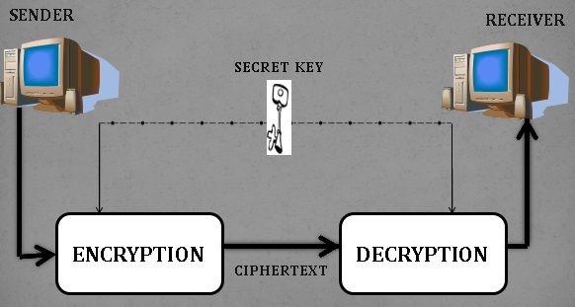
Secret/Symmetric Cryptography
The message (plaintext) is encrypted into ciphertext using a key.
The resulting ciphertext is sent to the recipient, who will decrypt it using the same key.
Hence, the same key must be known to both parties.
The best known secret-key system is the Data Encryption Standard (DES).
This method is easy and fast to implement but has weaknesses;
The algorithm that is used to encode the message is easier for attackers to understand, enabling them to more easily decode the message.

Slide 38
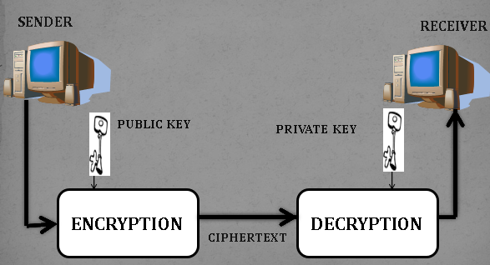
Public/Asymmetric Cryptography
The public key can only be used to encrypt the message and the private key can only be used to decrypt it.
This allows a user to freely distribute his or her public key to people who are likely to want to communicate with him or her without worry of compromise because only someone with the private key can decrypt a message.
To secure information between two users, the sender encrypts the message using the public key of the receiver. The receiver then uses the private key to decrypt the message.
The best-known public-key cryptosystem is RSA, named after its inventors: Rivest, Shamir, and Adleman.

Slide 39
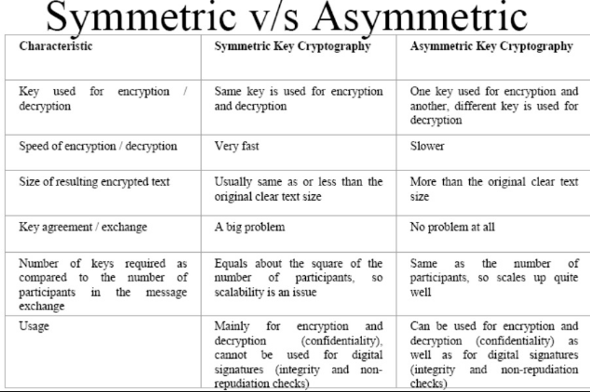

Slide 40
Digital Signature or E-signature
A digital signature is an electronic signature that can be used to authenticate the identity of the sender of a message or the signer of a document, and possibly to ensure that the original content of the message or document that has been sent is unchanged(Integrity).
Digital signatures are easily transportable, cannot be imitated by someone else, and can be automatically time-stamped. The ability to ensure that the original signed message arrived means that the sender cannot easily repudiate it later.
A digital certificate contains the digital signature of the certificate-issuing authority so that anyone can verify that the certificate is real.
Digital Signatures are a cryptographic technique and are one of the most important application of asymmetric public-key cryptography.

Slide 41
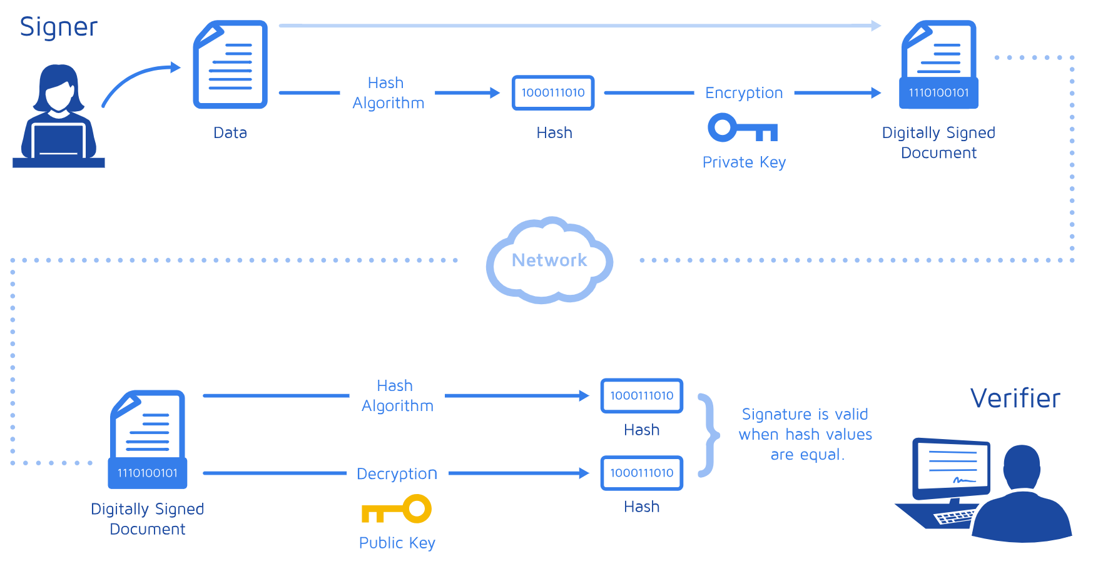

Slide 42
What is Digital Certificate and Certification authority ?
Digital certificate a digital document issued by a certification authority that contains the name of the subject or company, the subject’s public key, a digital certificate serial number, an expiration date, an issuance date, the digital signature of the certification authority, and other identifying information.
A digital certificate is a digital document issued by a trusted third-party institution known as a Certification authority (CA) that contains the name of the subject or company, the subject’s public key, a digital certificate serial number, an expiration date, an issuance date, the digital signature of the certification authority (the name of the CA encrypted using the CA’s private key),and other identifying information

Slide 43
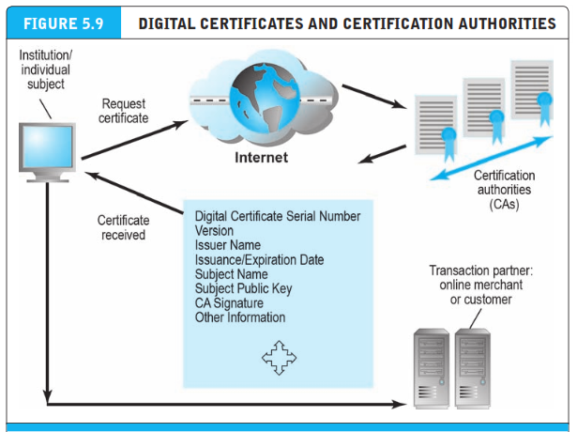
What is Digital Certificate and Certification authority ?
Certification authorities that issue, verify, and guarantee digital certificates that are used in e-commerce to assure the identity of transaction partners.
Public key infrastructure (PKI) refers to the CAs and digital certificate procedures that are accepted by all parties. When you sign into a “secure” site, the URL will begin with “https” and a closed lock icon will appear on your browser. This means the site has a digital certificate issued by a trusted CA. It is not, presumably, a spoof site.

Slide 44
Digital certificate and e-commerce site
Here are several ways the certificates are used in e-commerce. Before initiating a transaction, the customer can request the signed digital certificate of the merchant and decrypt it using the merchant’s public key to obtain both the message digest and the certificate as issued. If the message digest matches the certificate, then the merchant and the public key are authenticated. The merchant may in return request certification of the user, in which case the user would send the merchant his or her individual certificate. There are many types of certificates: personal, institutional, Web server, software publisher, and CAs themselves.
All forms of encryption have limitations
It is not effective against insiders
Protecting private keys may also be difficult because they are stored on insecure desktop and laptop computers
Additional technology solutions exist for securing channels of communications, networks, and servers/clients

Slide 45
Digital signatures vs Digital certificate
 | Digital signatures are electronically generated and can be used to ensure the integrity and authenticity of some data, such as an e-mail message and protect against non-repudiation
 | Digital certificate is a form of an electronic credential for the Internet. Similar to a driver's license, employee ID card, a Digital certificate is issued by a trusted third party to establish the identity of the certificate holder. The third party who issues the Digital Certificate is known as the Certifying Authority (CA).

Slide 46
Third party authentication
Someone who may be indirectly involved but is not a principal party to an arrangement, contract, deal, lawsuit, or transaction. Third party authentication work is to confirm the identify on the behalf of first and second party to make any transaction.
The Secure Sockets Layer (SSL) is a commonly-used protocol for managing the security of a message transmission on the Internet
E-commerce web sites use SSL (Secure Sockets Layer) to protect important information such as credit card numbers as they travel across the network.
SSL creates a private communication path between the web browser and the web server, encrypting all information that goes between the systems.
Most common web browsers have SSL support built in and e-commerce companies can purchase or get freely available web servers that support SSL.
Secure Sockets Layer (SSL)

Slide 47
Secure Sockets Layer (SSL)
SSL allows sensitive information such as credit card numbers, social security numbers, and login credentials to be transmitted securely. Normally, data sent between browsers and web servers is sent in plain text—leaving you vulnerable to eavesdropping. If an attacker is able to intercept all data being sent between a browser and a web server they can see and use that information.
More specifically, SSL is a security protocol. Protocols describe how algorithms should be used; in this case, the SSL protocol determines variables of the encryption for both the link and the data being transmitted.

Slide 48
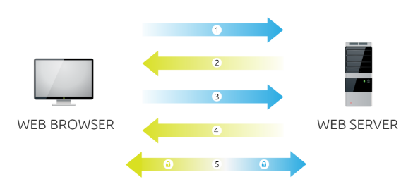
How does (SSL) work?
Browser connects to a web server (website) secured with SSL (https). Browser requests that the server identify itself.
Server sends a copy of its SSL Certificate, including the server’s public key.
Browser checks the certificate root against a list of trusted CAs and that the certificate is unexpired, unrevoked, and that its common name is valid for the website that it is connecting to. If the browser trusts the certificate, it creates, encrypts, and sends back a symmetric session key using the server’s public key.
Server decrypts the symmetric session key using its private key and sends back an acknowledgement encrypted with the session key to start the encrypted session.
Server and Browser now encrypt all transmitted data with the session key.

Slide 49
Securing e-commerce networks: Virtual private network (VPN)
A virtual private network (VPN) is a computer network that uses the Internet to provide remote offices or individual users with secure access to their organization's network by creating an encrypted path to that network.
Virtual private networks help distant colleagues work together, much like desktop sharing.
VPNs use both authentication and encryption to secure information from unauthorized persons. Authentication prevents spoofing and misrepresentation of identities. A remote user can connect to a remote private local network using a local ISP.
Virtual Private Network is a type of private network that uses public telecommunication, such as the Internet, instead of leased lines to communicate.
It allows remote users to securely access internal networks via the Internet, using the Point-to-Point Tunneling Protocol (PPTP)

Slide 50
Virtual private network (VPN)
A virtual private network (VPN) is a secure way of connecting to a private Local Area Network at a remote location, using the Internet or any unsecure public network to transport the network data packets privately, using encryption. The VPN uses authentication to deny access to unauthorized users, and encryption to prevent unauthorized users from reading the private network packets. The VPN can be used to send any kind of network traffic securely, including voice, video or data.

Slide 51
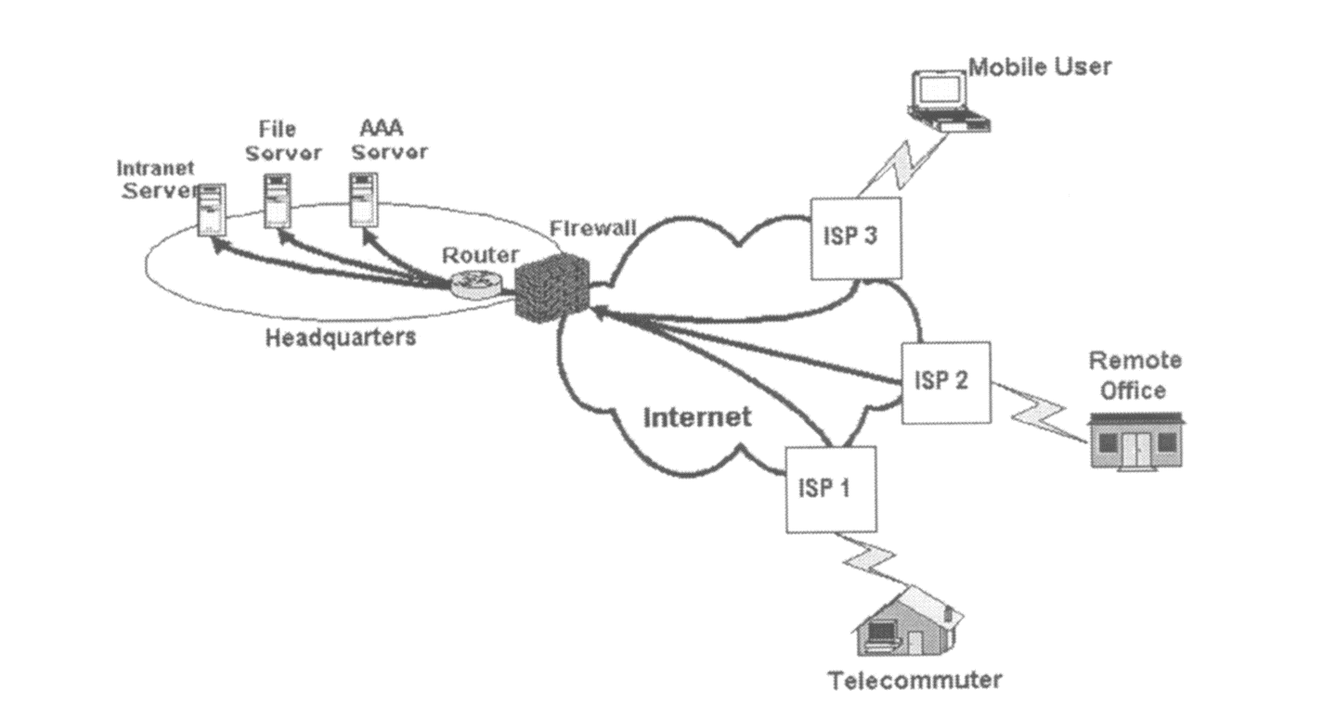
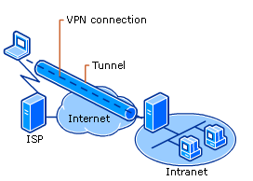
Virtual private network (VPN)

Slide 52
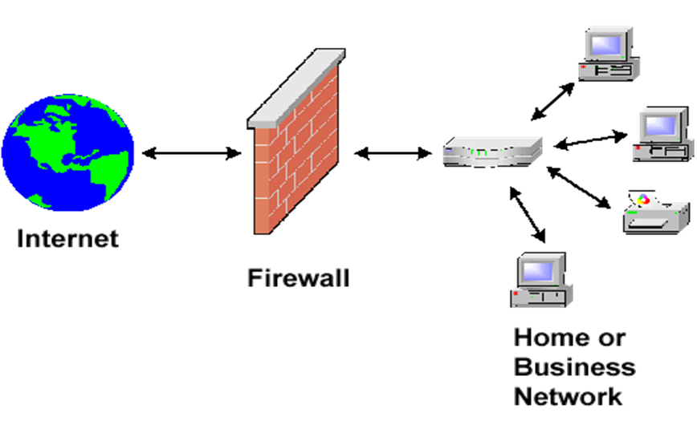
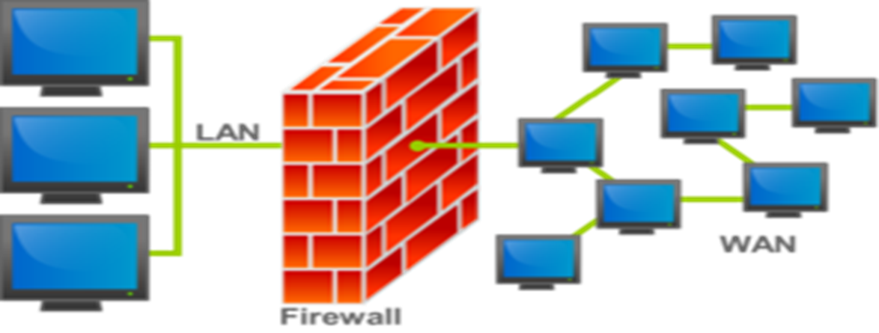
Securing e-commerce networks: Firewall
A firewall is a hardware or software designed to permit or deny network transmissions based upon a set of rules and is frequently used to protect networks from unauthorized access while permitting legitimate communications to pass.
A Firewall is hardware, software, or a combination of both which is used to prevent unauthorized programs or Internet users from accessing a private network and/or a single computer.

Slide 53
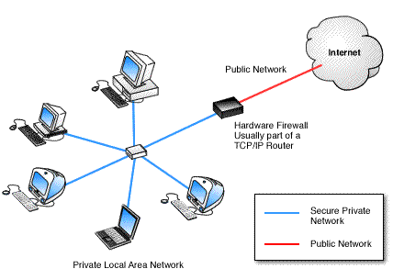
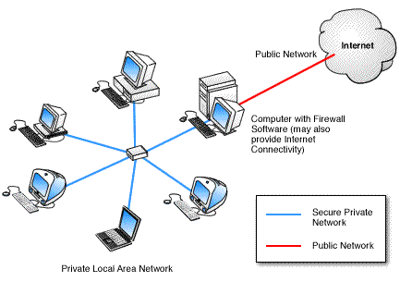
Hardware V/S Software firewall
Hardware Firewalls
Protect an entire network
Implemented on the router level
Usually more expensive, harder to configure
Software Firewalls
Install in a single computer and protect all
Usually less expensive, easier to configure
Figure 1: Hardware Firewall.
Hardware firewall providing protection
to a Local Area Network.
Figure 2: Computer with Firewall Software. Computer running firewall software that provide protection to PC..etc.,

Slide 54
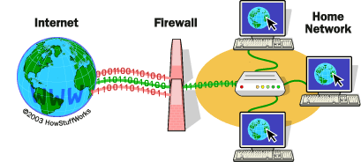
How does a software firewall work?
Inspects each individual “packet” of data as it arrives at either side of the firewall.
Determines whether it should be allowed to pass through or if it should be blocked.

Slide 55
Firewall Rules
Allow – traffic that flows automatically because it has been deemed
Block – traffic that is blocked because it has been deemed dangerous to your computer
Ask – asks the user whether or not the traffic is allowed to pass through

Slide 56
What Can a Firewall Do?
Focus for security decisions
Stop hackers from accessing your computer
Can enforce security policy
Protects your personal information
Limits your exposure
Blocks “pop up” ads and certain cookies
Can log Internet activity efficiently
Determines which programs can access the Internet

Slide 57
What Can't a Firewall Do?
Cannot protect against internal threats
For example, an angry employee deleting files
Or, an employee cooperating with an outside attacker
Cannot protect against attacks that bypass the firewall
Can't protect against completely new threats
Can't protect against viruses
Different operating systems and applications inside the network
Need to scan all incoming data…impractical, perhaps impossible

Slide 58
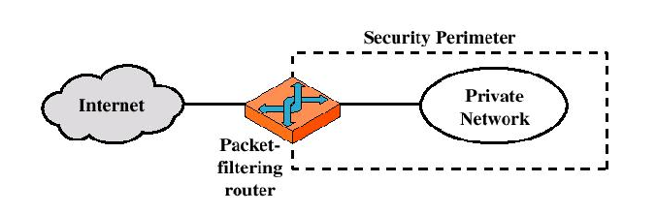
Types of firewalls
Packet-filtering Router
Applies a set of rules to each incoming IP packet and then forwards or discards the packet
Filter packets going in both directions
The packet filter is typically set up as a list of rules based on matches to fields in the IP or TCP header
Two default policies (discard or forward)
Advantages:
Transparency to users
High speed
Disadvantages:
Difficulty of setting up packet filter rules
Lack of Authentication

Slide 59
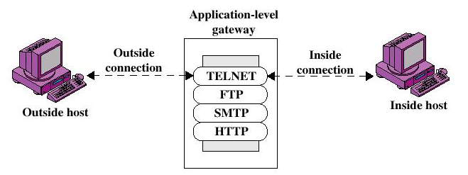
Types of firewalls
Application-level Gateway
Also called proxy server
Acts as a relay of application-level traffic
User contacts gateway through an application (e.g., telnet or FTP)
User must authenticate and provide name of remote host
Gateway connects to remote host and relays data back to the user
If code for an application is not implemented, gateway will not support that application
May be configured to support only certain features of an application
Advantages:
Higher security than packet filters
Only need to scrutinize a few allowable applications
Easy to log and audit all incoming traffic
Disadvantages:
Additional processing overhead on each connection (gateway as splice point)

Slide 60
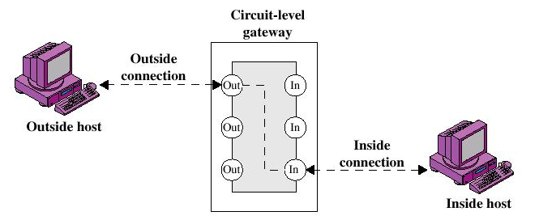
Types of firewalls
Circuit-level Gateway
Stand-alone system or Specialized function performed by an Application-level Gateway
Sets up two TCP connections
The gateway typically relays TCP segments from one connection to the other without examining the contents
The security function consists of determining which connections will be allowed

Slide 61
Characteristics of firewall
Service control
Determines the types of Internet services that can be accessed, inbound or outbound.
Direction control
Determines the direction in which particular service requests are allowed to flow.
User control
Controls access to a service according to which user is attempting to access it
Behavior control
Controls how particular services are used (e.g. filter e-mail)
All traffic from inside to outside must pass through the firewall .
Only authorized traffic will be allowed to pass.

Slide 62
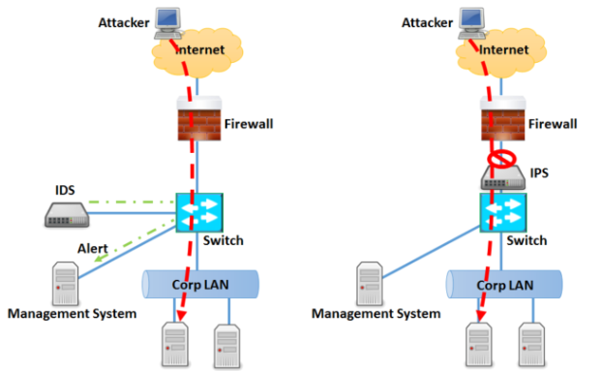
Intrusion Detection Systems (IDS)

Slide 63
Intrusion Detection Systems (IDS)
An intrusion detection system (IDS) is a device composed of software and/or hardware designed to monitor the activities of computer networks and computer systems in order to detect and define unauthorized and malicious attempts to access, manipulate, and/or disable these networks and systems.
An Intrusion Detection System (IDS) is a system that monitors network traffic for suspicious activity and issues alerts when such activity is discovered.
It is a software application that scans a network or a system for harmful activity or policy breaching. Any malicious venture or violation is normally reported either to an administrator or collected centrally using a security information and event management (SIEM) system.
A SIEM system integrates outputs from multiple sources and uses alarm filtering techniques to differentiate malicious activity from false alarms.

Slide 64
Intrusion Detection Systems (IDS)
Types of IDS:
Network Intrusion Detection System (NIDS):
Network intrusion detection systems (NIDS) are set up at a planned point within the network to examine traffic from all devices on the network. It performs an observation of passing traffic on the entire subnet and matches the traffic that is passed on the subnets to the collection of known attacks. Once an attack is identified or abnormal behavior is observed, the alert can be sent to the administrator. An example of an NIDS is installing it on the subnet where firewalls are located in order to see if someone is trying crack the firewall.
Host Intrusion Detection System (HIDS):
Host intrusion detection systems (HIDS) run on independent hosts or devices on the network. A HIDS monitors the incoming and outgoing packets from the device only and will alert the administrator if suspicious or malicious activity is detected. It takes a snapshot of existing system files and compares it with the previous snapshot. If the analytical system files were edited or deleted, an alert is sent to the administrator to investigate. An example of HIDS usage can be seen on mission critical machines, which are not expected to change their layout.

Slide 65
Intrusion Detection Systems (IDS)
Protocol-based Intrusion Detection System (PIDS):
Protocol-based intrusion detection system (PIDS) comprises of a system or agent that would consistently resides at the front end of a server, controlling and interpreting the protocol between a user/device and the server. It is trying to secure the web server by regularly monitoring the HTTPS protocol stream and accept the related HTTP protocol. As HTTPS is un-encrypted and before instantly entering its web presentation layer then this system would need to reside in this interface, between to use the HTTPS.
Application Protocol-based Intrusion Detection System (APIDS):
Application Protocol-based Intrusion Detection System (APIDS) is a system or agent that generally resides within a group of servers. It identifies the intrusions by monitoring and interpreting the communication on application specific protocols. For example, this would monitor the SQL protocol explicit to the middleware as it transacts with the database in the web server.
Hybrid Intrusion Detection System :
Hybrid intrusion detection system is made by the combination of two or more approaches of the intrusion detection system. In the hybrid intrusion detection system, host agent or system data is combined with network information to develop a complete view of the network system. Hybrid intrusion detection system is more effective in comparison to the other intrusion detection system. Prelude is an example of Hybrid IDS.

Slide 66
intrusion prevention System(IPS)
Intrusion Prevention System is also known as Intrusion Detection and Prevention System. It is a network security application that monitors network or system activities for malicious activity.
Major functions of intrusion prevention systems are to identify malicious activity, collect information about this activity, report it and attempt to block or stop it.
Comparison of IPS with IDS:
Intrusion prevention systems are placed in-line and are able to actively prevent or block intrusions that are detected.
IPS can take such actions as sending an alarm, dropping detected malicious packets, resetting a connection or blocking traffic from the offending IP address.
IPS also can correct cyclic redundancy check (CRC) errors, defragment packet streams, mitigate TCP sequencing issues and clean up unwanted transport and network layer options.

Slide 67
intrusion prevention System(IPS)
Types of IPS:
Network-based intrusion prevention system (NIPS):
It monitors the entire network for suspicious traffic by analyzing protocol activity.
2. Wireless intrusion prevention system (WIPS):
It monitors a wireless network for suspicious traffic by analyzing wireless networking protocols.
3. Network behavior analysis (NBA):
It examines network traffic to identify threats that generate unusual traffic flows, such as distributed denial of service attacks, specific forms of malware and policy violations.
4. Host-based intrusion prevention system (HIPS):
It is an inbuilt software package which operates a single host for doubtful activity by scanning events that occur within that host.

Slide 68
IPS VS IDS
PARAMETER | IPS | IDS
Abbreviation for | Intrusion Prevention System | Intrusion Detection System
System Type | Active (monitor & automatically defend) and/ or passive | Passive (monitor and Notify)
Detection mechanism | Statistical anomaly based detection Signature detection: Exploit-facing signatures Vulnerability-facing signatures | Signature detection: Exploit-facing signatures
Placement | Inline to data communication | Out of band from data communication
Anomaly response | Drop, alert or clean malicious traffic | Sends alarm/alert of detecting malicious traffic
Network performance impact | Slows down network performance due to delay caused by inline IPS processing | Does not impact network performance due to non-line deployment of IDS.
Benefits | Preferred by most organizations since detection and prevention are automatically performed | Does not block legitimate traffic which might be blocked by IPS at times.

Slide 69
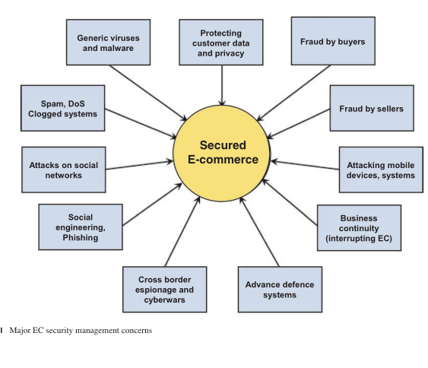
E-commerce Security Concern

